Slide 1
The Vermont Labor Market
Opportunities and Concerns

Slide 2
The Economic & Labor Market Information Division online @ VTLMI.info
Housed in the Vermont Department of Labor
State partner to the Federal Government
100% federally funded
Thank you to the USDOL Employment & Training Administration!
Purpose: to produce, explain and disseminate economic data for the benefit of the State of Vermont, educational institutes, employers, students, job-seekers, researchers, and the general public.
Notes:
Keep this to under 30 seconds.

Slide 3
MOMENT OF APPRECIATION
Thank you all for the work you do!!

Slide 4
Important note:
Data:
From the Vermont Dept of Labor, The Bureau of Labor Statistics and The Census Bureau Accurate! Consistent in methods and production!
Anything beyond the data:
My views, not those of the VDoL or the executive branch.
Please interrupt to ask questions or share comments. This is meant to be a discussion.

Slide 5
2020 Census – Partial Results
Vermont’s Population:
We thought for a decade… ~626k
Turns out we were climbing to… +643k!!!

Slide 6
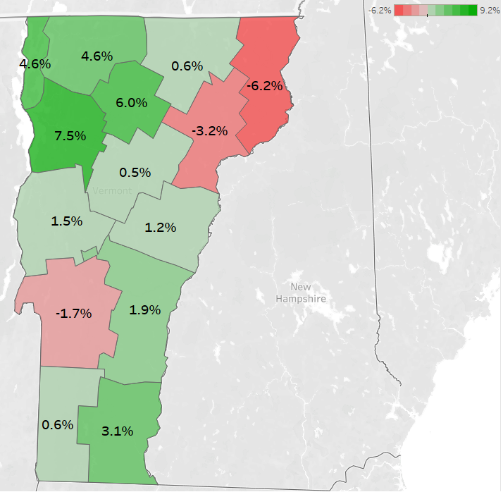
2020 Census – Partial Results 3 Counties Showed Population Declines

Slide 7
The Labor Market

Slide 8
Vermont Unemployment Rate (Seasonally Adjusted)
Notes:
U3 at Pre-pandemic levels.
In 30 seconds: Definition divergence and the

Slide 9
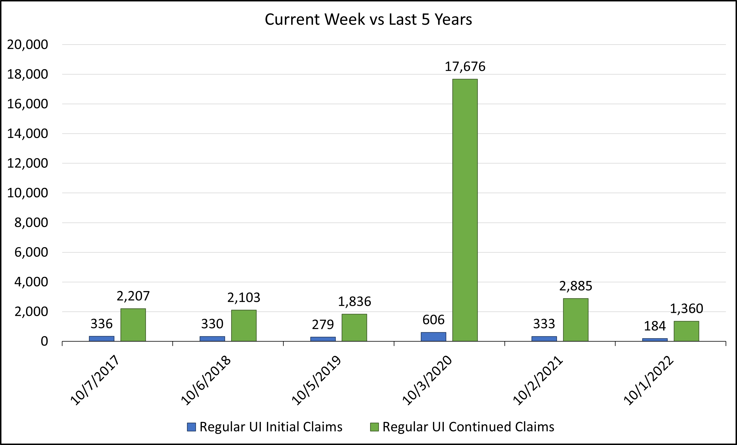

Slide 10
.

Slide 11
County Labor Force Data: Percent Change since Peak
County | % Change - ‘21 | Peak Year
Addison | -9.0% | 2009
Bennington | -17.8% | 2006
Caledonia | -16.8% | 2006
Chittenden | -7.3% | 2019
Essex | -21.0% | 2009
Franklin | -6.2% | 2019
Grand Isle | -8.5% | 2006
Lamoille | -14.6% | 2009
Orange | -9.0% | 2010
Orleans | -12.1% | 2009
Rutland | -19.4% | 2006
Washington | -9.4% | 2019
Windham | -19.8% | 2010
Windsor | -15.6% | 2009
Based on each county’s respective peak labor force numbers, all counties have seen a decline in labor force.
Franklin County has lost the least, 6.2% of its peak labor force. It is followed by northwest neighbors Chittenden (-7.3%) and Grand Isle (-8.5%)
Eight counties have seen a 10%+ decline in labor force.
Source: Local Area Unemployment Statistics Vermont Department of Labor

Slide 12
Labor Demand > Labor Supply It’s a seller’s market
February 2020
Unemployed: 9,000
Openings: 16,000
Quits: 7,000
1 unemployed person for every 1.8 job openings
July 2022
Unemployed: 7,000
Openings: 23,000
Quits: 11,000
1 unemployed person for every 3.3 job openings
This was considered a very tight labor market

Slide 13
Average Hourly Wages All workers and non-supervisory

Slide 14
Half the Story
Point 1 - Wages up locally due to decrease in labor supply
And now, on to the second half…

Slide 15
Business Formation Rates Over the Year Change
2016 >> 1.7% or 420 new establishments
2017 >> 1.9% or 480 new establishments
2018 >> 0.5% or 136 new establishments
2019 >> 1.2% or 309 new establishments
2020 >> 1.6% or 409 new establishments

Slide 16
Business Formation Rates Over the Year Change
2021 >> 5.9% or 1,545 new establishments
1,041 in Prof & Biz Services
- 807 in Prof & Tech Services
- 202 in Admin Services
129 in Information
102 in Financial Activities

Slide 17
Business Formation Rates Over the Year Change
Approx. 1,300 new establishments added 2,500 jobs NET but…
There were approx. 8k businesses already in these three areas; the +2.5k jobs includes new and previously existing businesses
Point 2 - Expanded regional competition for labor due to technology

Slide 18
*Version 4*
A Continued Partnership with the McClure Foundation
Highlighting E&LMI Data
(V5 in the works!)
Found online:
VTLMI.info
in the upper right
OR McClureVT.org

Slide 19
Thank you! (visit VTLMI.info)
Mathew Barewicz
Economic and Labor Market Information Division
Vermont Department of Labor
mathew.barewicz@Vermont.gov
www.VTLMI.info

