Slide 1


Connecting Vermonters with
Career and Education Resources.
Amanda Chase Ed.D, Director of Strategic Engagement (she/her)
Tom Cheney, Executive Director (he/him)

Slide 2

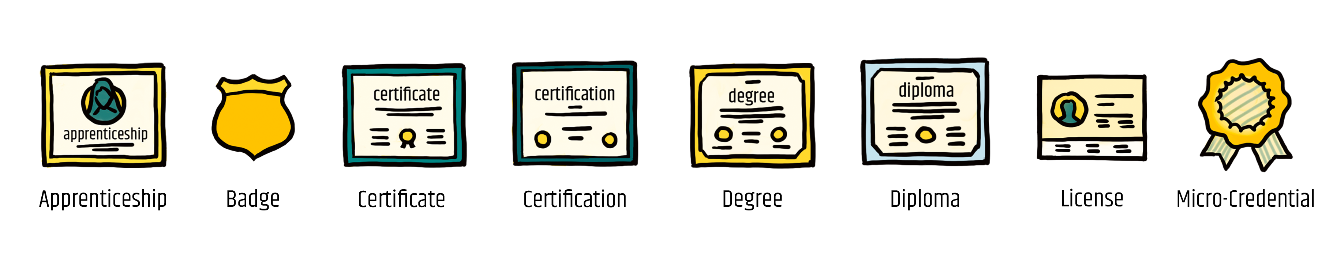
State Goal
70x2025
“It shall be the goal of the State of Vermont that not less than 70 percent of working age Vermonters will hold a credential of value, as defined by the State Workforce Development Board, by the year 2025”
– Act 80 of 2019

Slide 3

What Advance Vermont Does
Advance the civic and economic vitality of Vermont by:
Growing the number of Vermonters with education and training after high school
Increasing equity in educational attainment
Strengthening connections between education, training, and employment

Slide 4
Just Some of Our Partners
Alchemist Foundation
ACCD
AOE
Brattleboro Development Credit Corporation
Careers CLiC
Creative Workforce Solutions
CTE (youth and adult)
McClure Foundation
NEBHE
State Workforce Development Board
VDOL
Vermont State Colleges
University of Vermont
Vermont Adult Learning
Vermont Business Roundtable
VBSR
Vermont Community Engagement Lab
Vermont Principals Association
Vermont’s private colleges
Vermont School Counselors Association
VSAC
Vermont Talent Pipeline Management
Vermont VocRehab
Vermont Works for Women

Slide 5

Problem Statement
Sifting through hundreds of resources to identify, evaluate, and access relevant information is confusing, costly, and time consuming.
Vermonters need accessible and clear information about their education, training, and career options.

Slide 6


Vermont’s free one-stop shop for education and career resources.

Slide 7


MyFutureVT
Designed with the User at the Center.
Target Audience: Job seekers, prospective students, and navigators; all Vermonters but especially disadvantaged populations
Designed to be:
  Accessible for people with disabilities and is written at an 8th grade reading level
  Works on a mobile device
  Bright, colorful and engaging

Slide 8
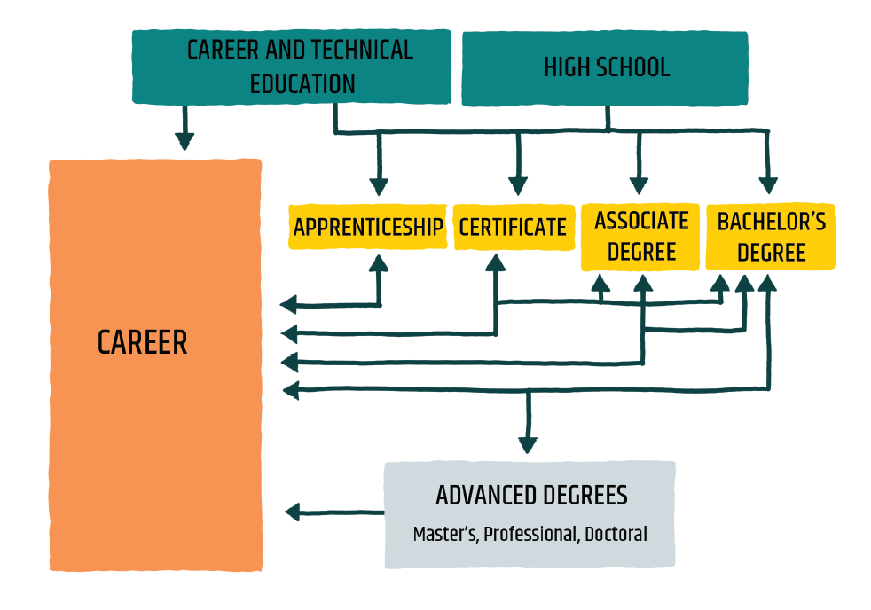
Dialing it in.
User Centered Language & Tone
Emphasize empowerment and choice
Focus on inclusive language
Consider the end goal
Reinforce the variety of credentials
Introduce stackable credentials

Slide 9




EXPLORE CAREERS
3 Entry Points.
Every user will have different goals.
Our hope is to meet them where they are.
FIND TRAINING AND EDUCATION
GET SUPPORT

Slide 10
Career Exploration & Preparation
EXPLORE CAREERS
Careers database
Strength & interest assessments
Exploration tools
Job search tips
.
FIND TRAINING AND EDUCATION
GET SUPPORT

Slide 11
Education & Training Information
EXPLORE CAREERS
Education & training program database
Education and training pathways for any stage of life
Credential explanations & career connections
Cost reduction strategies
.
FIND TRAINING AND EDUCATION
GET SUPPORT

Slide 12

Career & Education Resources
EXPLORE CAREERS
Database of education and career support services
In-person career and education counseling services
Resources to make empowered choices
Can search by identity, location, population, and more
.
FIND TRAINING AND EDUCATION
GET SUPPORT

Slide 13

Help us get the word out and grow!
Recommend and demo MyFutureVT with clients
Let us know who would benefit from a workshop
Give us feedback on the site (survey link on site)
Like Advance Vermont on Facebook, Twitter & LinkedIn
Share MyFutureVT in social media, newsletters etc. using our Navigator Toolkit
Simply continue what you are doing—thank you!

Slide 14
Thank you. Please be in touch.
Amanda Chase, Director of Strategic Engagement
chase@advancevermont.org
Tom Cheney, Executive Director
cheney@advancevermont.org
Visit advancevermont.org & MyFutureVT.org
Follow us on Twitter, Facebook, LinkedIn
@advancevt

